Slide 1
RSM222
Management Accounting 1
Class 10: Relevant Costs for Decision Making
Elisa Zuliani

Slide 2
Learning Objectives
Describe management’s decision-making process and incremental analysis.
Analyze the relevant costs in the following scenarios:
  repairing, retaining, or replacing equipment
  deciding whether to eliminate an unprofitable segment
  make-or-buy decision
  Special order
  Sell or process materials further.
Utilization of Constrained Resource
Relevant costing is an overall concept rather than a specific method to apply. It
provides managers with a tangible approach to making decisions.

Slide 3






Let’s think about a “Relevant” Deicsion
University Decision
U of T
Queen’s
McMaster
Western
Guelph
What made you choose U of T? Rotman?

Slide 4
The Decision- Making Process
Identify the problem and assign responsibility
Determine and evaluate possible courses of action
  Collect and verify relevant information
Make a decision
  Consider financial and non- financial information
Review results of the decision
Manager is Faced with a Problem
Alternative 1
Alternative 2
Alternative 3
Etc.
Etc.
How can you choose the best alternative?

Slide 5
Why is this “Relevant”?
Imagine if you had to prepare a Full Pro-Forma for each alternative…
Effective, Timely Decision Making
Irrelevant costs usually outnumber the relevant costs.
  Focusing on relevant costs simply takes less time and effort.
Information generation is costly
2. Irrelevant costs together with relevant costs may draw the decision-makers attention away from the critical data.
Individuals face information overload
The concept of relevant costs eliminates unnecessary data that could
complicate the decision-making process.

Slide 6
Where does Management Accounting fit ?
What is the purpose of MGT Accounting? (How many times have I asked this question…)
Managerial Accountant designs and implements accounting information system
Relevant Information is provided to management to make production, marketing, finance, and other decisions
Decision is Made
The managerial accountant is responsible for designing and maintaining the
accounting system that will deliver relevant information to decision-makers.

Slide 7

Terminology
AVOIDABLE / DIFFERENTIAL COSTS/BENEFITS
Can be eliminated (costs) or received (benefits) in whole or in part by choosing one alternative over another.
RELEVANT
SUNK
COSTS
All past costs that cannot be changed by any decision made now or in the future.
Are Opportunity
Costs relevant?
NON-AVOIDABLE COSTS
/BENEFITS
Future costs and benefits that do not differ
between alternatives.
A relevant cost is a cost that differs between alternatives.

Slide 8
What is “Relevant”?
To affect a decision a cost/benefit must be:
Future Oriented
  Past costs are irrelevant, as we cannot affect them by current decisions, and they are common to all alternatives that we may choose.
Incremental
  Must be incurred, earned, or avoided as a result of making a decision.
Impact Cash flow
  Expenses such as depreciation are not cash flows and are therefore not relevant. Similarly, the book value of existing equipment is irrelevant, but the disposal value is relevant.
Always consider the context. Costs that are relevant in one decision situation may not be relevant in another.

Slide 9
Relevant Cost Analysis: A Two-Step Proces
To identify the costs and benefits that are relevant in a particular decision situation, these steps should be followed:
  Eliminate costs and benefits that do not differ between alternatives.
  Use the remaining costs and benefits that differ between alternatives in making the decision. The costs that remain are the differential, or avoidable, costs.

Slide 10
Identifying Relevant Costs
Cynthia, an MBA student in Halifax, is considering visiting her friend in Moncton over the weekend. She needs to decide whether to drive or to take the train. By car, it is 280 kilometers to her friend’s apartment. Which alternative is least expensive?
$1.80 litre ÷ 10 km per litre
$24,000 cost – $10,000 salvage value ÷ 5 years
$45 per month x 8 months

Slide 11
Identifying Relevant Cost

Slide 12
Identifying Relevant Cost
Cost | Relevant / Not Relevant | Why
Car | Not Relevant - Sunk | not relevant to the current decision.
Insurance | Not Relevant | It will remain the same whether she drives or takes the train
Gasoline | Relevant | If she takes the train, the cost would not be incurred, so it varies depending on the decision.
Monthly school parking fee | Not Relevant | must be paid whether Cynthia drives or takes the train.
Round-trip train fare | Relevant | If she drives the cost can be avoided. Relaxing on the train is relevant even though it is impossible to assign a dollar value to the benefit.
Kennel cost for the dog | Not Relevant | Cynthia will incur the cost whether she drives or takes the train.
Cost of parking | Relevant | it can be avoided if she takes the train.
The problems of finding a parking space | Relevant | impossible to assign a dollar amount

Slide 13
Identifying Relevant Costs
From a financial standpoint, Cynthia would be better off taking the train to visit her friend. Some of the non-financial factors may influence her final decision.

Slide 14
Types of Decision
Keep or replace
Make or buy
Sell now or process further
Continue or discontinue product line
Accept or reject special offer
Change credit terms
Open new territory
Buy or lease
Constraints
…
Whatever the situation:
Only consider the relevant costs and benefits that differ among alternatives.
Consider Qualitative
Support
The underlying principles of relevant costing can be related to anything involving financial decisions.

Slide 15

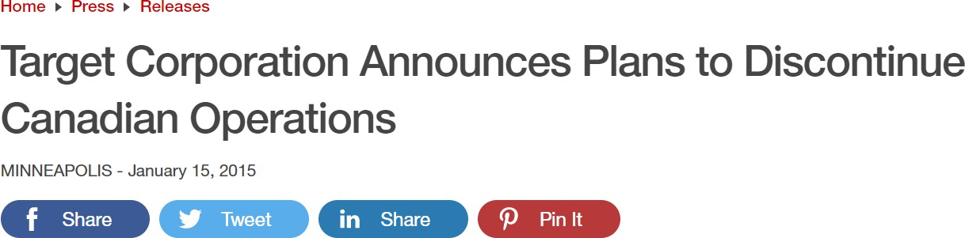
Real-Life Example
https://corporate.target.com/press/releases/2015/01/target-corporation-announces-plans-to-discontinue
Even Target itself admits the Canadian business was plagued with problems. "We tried to do too much, too fast," says spokeswoman Molly Snyder. "We have a lot of operational challenges. From how sharp we are on pricing ... we certainly had supply chain and logistics issues."

Slide 16
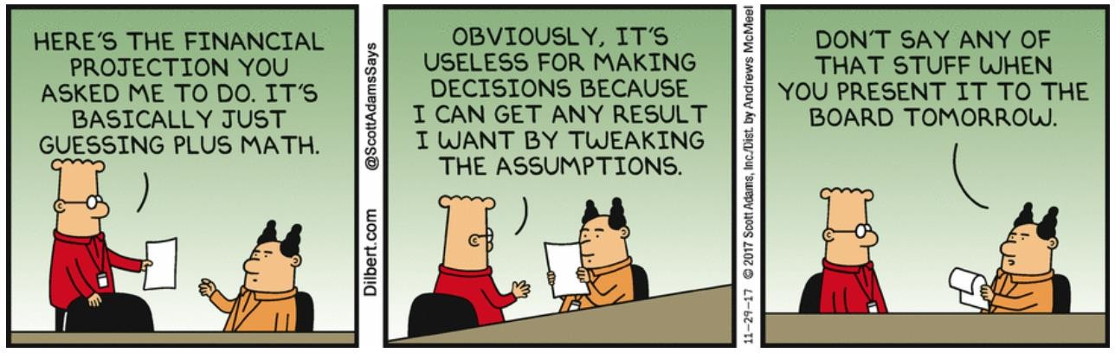
Assumptions & Sensitivity
More Uncertainty
=
More Assumptions
A decision can only be as reliable as the information for which it is based upon
  All decisions involve making assumptions and estimates about the future
  As the time horizon increases so to does uncertainty
Useful to redo the analysis under different assumptions and estimates to determine the sensitivity of the conclusions.

Slide 17

Qualitative Factors
Quantitative Factors
“…Tim Hortons regulars launch boycott over minimum wage response.”
Qualitative Factors
"Not everything that can be counted counts, and not everything that counts can be counted."
Albert Einstein

Slide 18

The “Newspaper Test”
https://www.youtube.com/watch?v=GNF793Inghg
“I ask the managers to judge every action they take — not just by legal standards, though obviously that’s the first test — but also by what I call the ‘newspaper test.’”
“How would feel about any given action if it was to be written up the next day in the local newspaper by a smart but unfriendly reporter and read by their family, friends and neighbors?”
““If [the decision] passes that test, it’s okay. If anything is too close to the lines, it’s out.”

Slide 19
Repairing or Replacing Equipment

Slide 20
Replacing Equipment
The management of a company is considering renting a new labour-saving machine for $3,000 per year. Data about the company’s annual sales and costs with and without the new machine are:

Slide 21
Replacing Equipment
The only costs that differ between the alternatives are the direct labour costs savings and the increase in fixed rental costs.
The decision can be efficiently analyzed
by considering only the differential costs
to arrive at the same conclusion.

Slide 22
Replacing Equipment
Using the differential approach is desirable for two reasons:
  Only rarely will enough information be available to prepare detailed income statements for both alternatives.
  Blending irrelevant costs with relevant costs may cause confusion and distract attention away from the information that is really critical.

Slide 23
Adding or Dropping a Segment

Slide 24
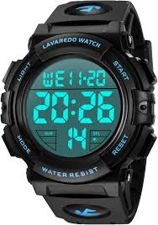
Application Example - Adding / Dropping Segments
Example:
Due to the declining popularity of digital watches, Lovell Company’s digital watch line has not reported a profit for several years. Lovell is considering discontinuing this product line.
Lovell should drop the digital watch segment only if its profit would increase. This would only happen if the fixed cost savings exceed the lost contribution margin.

Slide 25
Application Example - Add/ Dropping Segments

Slide 26
Application Example - Adding / Dropping Segments
Total fixed general factory overhead and general administrative expenses would not be affected if the digital watch line is dropped. The fixed general factory overhead and general administrative expenses assigned to this product would be reallocated to other product lines.

Slide 27
Application Example - Adding / Dropping Segments
The equipment used to manufacture
digital watches has no resale
value or alternative use.
Should Lovell retain or drop
the digital watch segment?

Slide 28
Application Example - Adding / Dropping Segments

Slide 29
Application Example - Adding / Dropping Segments
The Lovell solution can also be obtained by preparing comparative income statements showing results with and without the digital watch segment.
If the digital watch line is dropped, the company gives up its contribution margin.

Slide 30
Application Example - Adding / Dropping Segments
The general factory overhead would be the same, so this cost is not relevant.

Slide 31
Application Example - Adding / Dropping Segments
The product line manager would no longer be needed.

Slide 32
Application Example - Adding / Dropping Segments
If the digital watch line is dropped, the net book value of the equipment would be written off. The depreciation that would have been taken will flow through the income statement as a loss instead.

Slide 33
Application Example - Adding / Dropping Segments

Slide 34
Application Example - Adding / Dropping Segments
Beware of Allocated Fixed Costs:
Why should the digital watch segment be kept when it’s showing a $100,000 loss?
The answer lies in the way common fixed costs are allocated to products.
Allocations can make a segment look less profitable than it really is.
If the segment is dropped, those common fixed costs will need to be transferred to other segments.
The company loses all the contribution margin but does not save all the costs.

Slide 35
Make or Buy

Slide 36
Application Example: Make or Buy
Essex Company manufactures Part 4A that is used in one of its products.
The unit product cost to make this part is:

Slide 37
Application Example: Make or Buy
The special equipment used to manufacture Part 4A has no resale value.
The total amount of general factory overhead, which is allocated on the basis of direct labour hours, would be unaffected by this decision.
The $30 unit product cost is based on 20,000 parts produced each year.
An outside supplier has offered to provide the 20,000 parts at a cost of $25 per part.
Should the supplier’s offer be accepted?

Slide 38
Application Example: Make or Buy
20,000 × $9 per unit = $180,000

Slide 39
Application Example: Make or Buy
The special equipment has no resale value. It is a sunk cost.

Slide 40
Application Example: Make or Buy
General factory overhead is not avoidable, so it is irrelevant. If the product is purchased, general factory overhead will be reallocated to other products.

Slide 41
Application Example: Make or Buy
Should the company make or buy Part 4A?

Slide 42
Application Example: Make or Buy
An opportunity cost is the benefit that is given up as a result of pursuing some course of action.
Opportunity costs are not actual dollar outlays and are not recorded in the formal accounts of an organization.
What opportunity costs should Essex Company consider?
© 2024 McGraw Hill Limited
12-42

Slide 43
Special Order

Slide 44
Special Order
A special order is a one-time order that is not considered part of the company’s normal ongoing business.
When analyzing a special order, only the incremental costs and benefits are relevant.

Slide 45
Application Example: Special Order
Jet, Inc. makes a single product with a normal selling price of $20 per unit.
A foreign distributor has offered to purchase 3,000 units for $10 per unit.
This is a one-time order that would not affect the company’s regular business.
Annual capacity is 10,000 units, but Jet, Inc. is currently producing and selling only 5,000 units.
Should Jet accept the offer?

Slide 46
Application Example: Special Order
$8 per unit variable cost

Slide 47
Application Example: Special Order
If Jet accepts the special order, the incremental revenue will exceed the incremental costs and operating income will increase by $6,000.
This suggests that Jet should accept the order.
This answer assumes that the fixed costs are unavoidable and that variable marketing costs must be incurred on the special order.

Slide 48
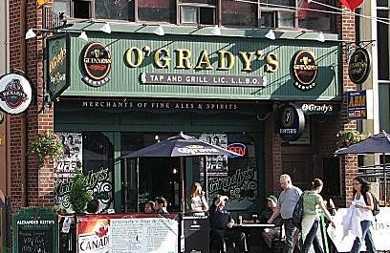

Application Example #2: Special Order
The Canadian Government has guaranteed the purchase of 10,000 bottles of sanitizer for $2.50 each and the potential for increased orders and cost depending on the scarcity of the product.
  The regular selling price for a bottle of beer is $4.75.
  To alter the manufacturing process, College Street Pubs must pay a one-time fee of
$5,000
  The management accountant for College Street Pubs has produced the following costs:
Variable cost | Per Unit
Direct materials | $1.25
Direct labour | $.15
Variable manufacturing overhead | $.25
Fixed Costs (total) | $100,000
Accept?

Slide 49
Application Example #2: Special Order
 | Per Unit | Total
Revenue | $2.50 | $25,000
Direct Materials | ($1.25) | ($12,500)
Direct Labour | ($.15) | ($1,500)
Variable manufacturing overhead | ($.25) | ($2,500)
Contribution Margin | $.85 | $8,500
Added “Fixed Cost” |  | ($5,000)
Incremental Profit |  | $3,500
Fixed Overhead is irrelevant. Whether or not this order is accepted, College Street Pubs will have to pay it
What if the Canadian Government offered to reduce Income Taxes, Property Taxes, labour costs etc. for College Street Pubs to produce?
Why is there no Opportunity Cost?
Consider Qualitative Support for accepting/rejecting this order
  Reputation, Sense of Service, etc.

Slide 50
Sell or Process Further

Slide 51
Joint Product Costs
In some industries, multiple end products are produced from a single raw material input.
Two or more products produced from a common input are called joint products.
The point in the manufacturing process where multiple products can be produced is called the split-off point

Slide 52
Joint Product Costs
Joint
Costs
Oil
Joint
Input
Common
Production
Process
Gasoline
Chemicals
Split-Off
Point

Slide 53
Joint Product Costs
Joint
Costs
Separate
Processing
Final
Sale
Oil
Joint
Input
Common
Production
Process
Gasoline
Final
Sale
Separate
Processing
Final
Sale
Chemicals
Split-Off
Point
Separate
Product
Costs

Slide 54
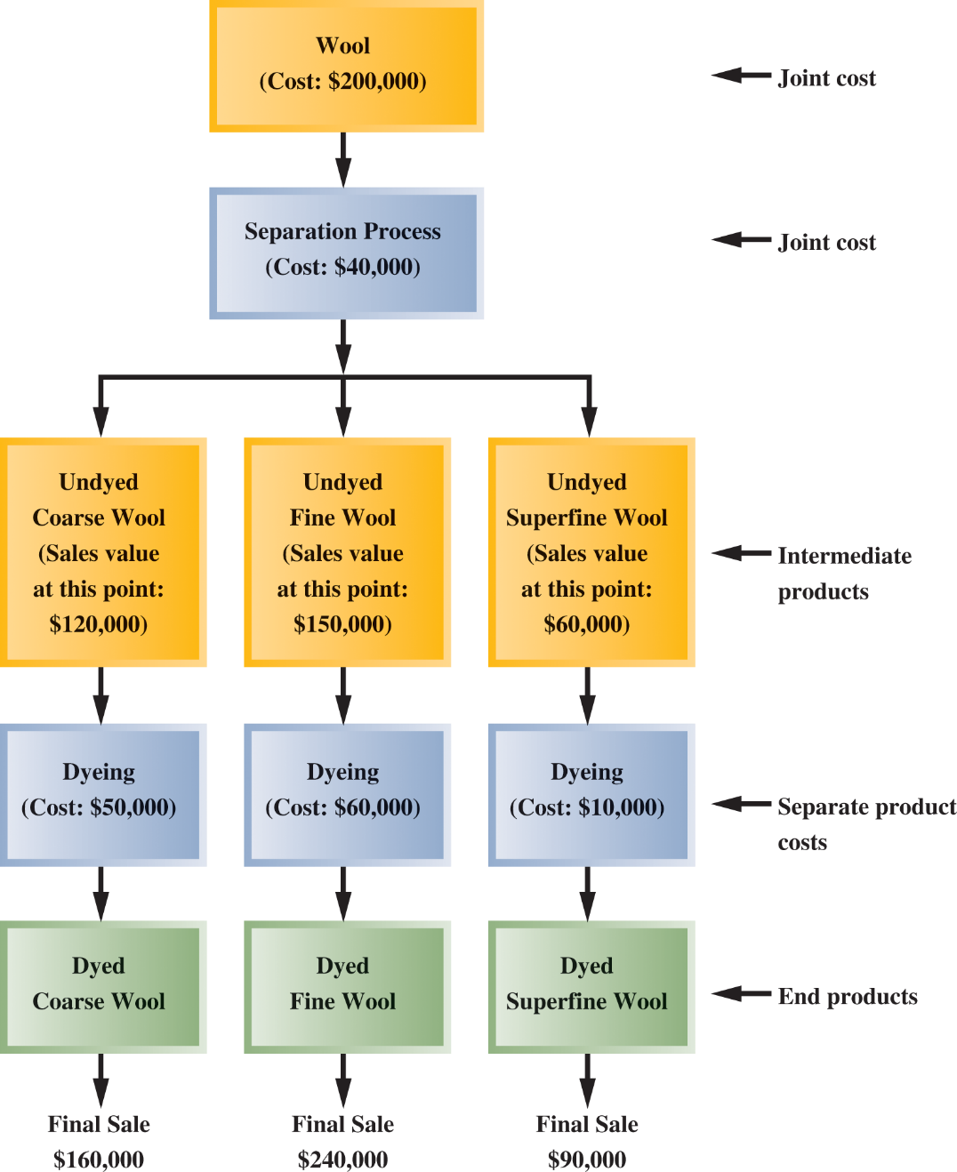
Joint Product Costs
Exhibit 12-6
Joint
Input

Slide 55
Sell or Process Further
Joint costs are often allocated to end products on the basis of the relative sales value of each product or on some other basis.
Although allocation is needed for balance sheet inventory valuation, allocations of this kind should be avoided for decision making.
Joint costs are irrelevant in decisions regarding what to do with a product from the split-off point forward.
It will always be profitable to continue processing a joint product after the split-off point if the incremental revenue exceeds the incremental processing costs incurred after the split-off point.

Slide 56
Application Example: Sell or Process Further
Sawmill, Inc. cuts logs from which unfinished lumber and sawdust are the immediate joint products.
Unfinished lumber can be sold ‘as is’ or processed further into finished lumber.
Sawdust can also be sold ‘as is’ to gardening wholesalers or processed further into ‘presto-logs.’

Slide 57
Application Example: Sell or Process Further
Data about Sawmill’s joint products:

Slide 58
Application Example: Sell or Process Further

Slide 59
Application Example: Sell or Process Further

Slide 60
Application Example: Sell or Process Further
Which product should be processed further?

Slide 61
Utilization of Constrained Resource

Slide 62
Utilization of a Constrained Resource
When a limited resource of some type restricts the company’s ability to satisfy demand, the company is said to have a constraint.
The theory of constraints (TOC) maintains that effectively managing a constraint is important to the financial success of an organization.
The challenge is deciding how to best utilize the constrained resource to maximize the company’s profits.

Slide 63
Utilization of a Constrained Resource
When a constraint exists, a company should select a product mix that maximizes the total contribution margin earned, since fixed costs usually remain unchanged.
A company should not necessarily promote those products that have the highest unit contribution margin.
Rather, it should promote those products that earn the highest contribution margin in relation to the constrained resource.

Slide 64
Application Example: Constrained Resource
Ensign Company produces two products.
Selected data are shown below:

Slide 65
Application Example: Constrained Resource
Machine A1 is the constrained resource.
It is currently being used at 100% of its capacity of 2,400 minutes per week.
There is excess capacity on all other machines.
Should Ensign focus its efforts on Product 1 or Product 2?

Slide 66
Application Example: Constrained Resource
The key is the contribution margin per unit of the constrained resource.
Product 2 should be emphasized. It provides more valuable use of the constrained resource, Machine A1, because it provides a contribution margin of $30 per minute as opposed to $24 per minute for Product 1.

Slide 67
Application Example: Constrained Resource
The key is the contribution margin per unit of the constrained resource.
If there are no other considerations, the best plan is to produce enough Product 2 to meet current demand and then use any remaining capacity of Machine A1 to produce Product 1.

Slide 68
Application Example: Constrained Resource
Determine how many units should be made.

Slide 69
Application Example: Constrained Resource
Determine how many units should be made.

Slide 70
Determine how many units should be made.

Slide 71
Application Example: Constrained Resource
For maximum contribution margin, 1,300 units of Product 1 and 2,200 units of Product 2 and should be produced.
Ensign’s total contribution margin is $64,200.

Slide 72
Applicaton Example #2 : Special Order with Constraints
Dineen was asked to make 200 cakes @ $12.50 for the upcoming weekend. While Dineen would normally decline the request, weekends in November are typically very slow. This order would have no effect on the company's normal sales and would not change the total amount of the company's fixed costs.
The cost of producing and selling a single cake at the normal activity level are:
  Direct Materials $7.40
  Direct Labour $1.45
  Variable Manufacturing Overhead $.63
  Fixed Manufacturing Overhead $4.30
  Variable Selling & Administrative Expense $.45
  Fixed Selling & Administrative Expense $1.68
The normal selling price of a cake is $20 per unit.
Should the offer be accepted?

Slide 73
Application Example #2: Special Order with Constraints
Incremental Contribution Margin
CM = (Sales –VC) * # of Units
= ($12.50 -$7.40 -$1.45 -$.63 -$.45) * 200
= $2.57*200
= $514
Suppose Dineen is already booked for the weekend. What would be the opportunity cost of the cakes?
Opportunity Cost = Lost CM of Normal Cakes
= (Sales –VC) * # of Units
= ($20-$7.40 -$1.45 -$.63 -$.45) * 200
= $10.07 * 200
= $2014
What does this mean?

Slide 74
Application Example #2: Special Order with Constraints
Suppose there is not enough idle capacity to produce all of the cakes and accepting the special order would require cutting back on production of 130 units for regular customers.
What would be the minimum acceptable price per unit for the special order?
Lost CM of Displaced Sales:
= 10.07 * 130 = $1,309.10
VC of 200 cakes:
= ($7.40 +$1.45 + $.63 + $.45) * 200
= $9.93 *200= $1,986
Total Cost
=$1,309.10 + $1,986
= $3,295.10
Cost per Unit
= Total Cost/# of Units
= $3,295.10/200
= $16.47

Slide 75
Managing Constraints
Profits can be increased by effectively managing constraints. One aspect of managing constraints is to decide how best to utilize them.
Managers should focus on managing bottlenecks and finding ways to increase the capacity at the bottlenecks:
  Improve the process
  Add overtime or another shift
  Hire new workers or acquire more machines
  Subcontract production
  Reduce the number of defective units produced
  Add workers transferred from non-bottleneck departments

Slide 76
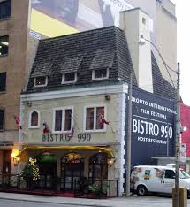
IN CLASS EXAMPLE
Belair Bistro

Slide 77
Any Questions?

